Slide 1
Python Programming
Prof. Sujit M. Deokar,
Department of Engineering & Sciences Humanities
Vishwakarma Institute of Technology, Pune

Slide 2
Introduction

Slide 3
Learning Outcomes

Slide 4
Index
Introduction

Slide 5
What Is a Program?
Usually, one or more algorithms written in a programming language that can be translated to run on a real machine
We sometimes call programs software

Slide 6
What Is a Programming Language?
A programming language is somewhat like a natural language, but with a very limited set of statements and strict syntax rules.
Has statements to implement sequential, conditional and iterative processing - algorithms
Examples: FORTRAN, COBOL, Lisp, Basic, Pascal, C, C⁺⁺, Java, C#, Python, …

Slide 7
Compiler
A compiler is a program that converts a program written in a programming language into a program in the native language, called machine language, of the machine that is to execute the program.

Slide 8
From Algorithms to Hardware (with compiler)
Algorithm
Translate (by a human being)
Program
Translate (by compiler program)
A real computer

Slide 9
The Program Development Process (Data Flow)
Algorithm
Editor
Program in programming language
Compiler
Program in machine’s language
A real computer
Input
Output

Slide 10
The Program Development Process (Control Flow)
Edit
Syntax errors
Compile
Run
Input
Output
Runtime errors

Slide 11
Three kinds of errors
Syntax error : Some statement in the program is not a legal statement in the language.
Runtime error : An error occurs while the program is executing, causing the program to terminate (divide by zero, etc.)
Logic error : The program executes to completion, but gives incorrect results.

Slide 12
Interpreter
An alternative to a compiler is a program called an interpreter. Rather than convert our program to the language of the computer, the interpreter takes our program one statement at a time and executes a corresponding set of machine instructions.

Slide 13
Interpreter
Edit
Syntax or runtime errors
Input
Interpreter
Output

Slide 14
Python
Python is a real-world, production language that is freely available for most computers. http:www.python.org
If you want a copy of Python to use with this course, go to http://code.google.com/p/mediacomp-jes/ . We are using JES (Jython Environment for Students) which has a lot of special multimedia functionality.
Note: Our textbook covers a limited amount of Python. There are many excellent online tutorials. For example, see http://en.wikibooks.org/wiki/Non-Programmer's_Tutorial_for_Python/Contents

Slide 15
Python
Python uses an interpreter. Not only can we write complete programs, we can work with the interpreter in a statement by statement mode enabling us to experiment quite easily.
Python is especially good for our purposes in that it does not have a lot of “overhead” before getting started.
It is easy to jump in and experiment with Python in an interactive fashion.

Slide 16
Language terminology
Syntax: The formal rules for legal statements in the language.
Semantics: The meaning of the statements - what happens when the statement is executed.

Slide 17
Three major control constructs of programming (Execution flow of instructions)
Sequential: Simply do steps one after the other in order they are listed.
Conditional: Decide which statement to do next based on some true/false test.
Iterative: A set of statements is repeated over and over until some condition is met.

Slide 18
Sequential Operations “Atomic”
Step i
Input
Computation
Output
Step i+1
Step i+2

Slide 19
The Big Plan
We want to get some experience of programming simple algorithms in a real programming language. This gives us an understanding of how software is written and allows us to test our algorithms to see if they work.
We’ll first work with programs where the variables have numbers as values.
Later we’ll work with programs dealing with pictures and sound.
In lab we’ll work with some simple statements and small programs.

Slide 20
The Basic Pattern
Most of our programs will use the basic pattern of
Get some user input
Perform some algorithm on the input
Provide results as output

Slide 21
Identifiers
Identifiers are names of various program elements in the code that uniquely identify the elements. They are the names of things like variables or functions to be performed. They're specified by the programmer and should have names that indicate their purpose.
In Python, identifiers
Are made of letters, digits and underscores
Must begin with a letter or an underscore
Examples: temperature, myPayrate, score2

Slide 22
Keywords
Keywords are reserved words that have special meaning in the Python language. Because they are reserved, they can not be used as identifiers. Examples of keywords are if, while, class, import.

Slide 23
Variables in Python
A variable has
A name – identifier
A data type - int, float, str, etc.
Storage space sufficient for the type.

Slide 24
Numeric Data Types
int This type is for whole numbers, positive or negative. Examples: 23, -1756
float This type is for numbers with possible fraction parts. Examples: 23.0, -14.561

Slide 25
Integer operators
The operations for integers are:
+ for addition
- for subtraction
* for multiplication
/ for integer division: The result of 14/5 is 2
% for remainder: The result of 14 % 5 is 4
*, /, % take precedence over +, -
x + y * z will do y*z first
Use parentheses to dictate order you want.
(x+y) * z will do x+y first.

Slide 26
Integer Expressions
Integer expressions are formed using
Integer Constants
Integer Variables
Integer Operators
Parentheses

Slide 27
Python Assignment Statements
In Python, = is called the assignment operator and an assignment statement has the form <variable> = <expression>
Here
<variable> would be replaced by an actual variable
<expression> would be replaced by an expression
Python: age = 19

Slide 28
Python Assignment Statement
Syntax: <variable> = <expression>
Note that variable is on left
Semantics:
Compute value of expression
Store this as new value of the variable
Example: Pay = PayRate * Hours
10
40
400
Payrate
Hours
Pay

Slide 29
Assignment Example
Before
X
3
Y
5
Z
12
Execute
Z = X * 3 + Z / Y
After
X
3
Y
5
Z
11

Slide 30
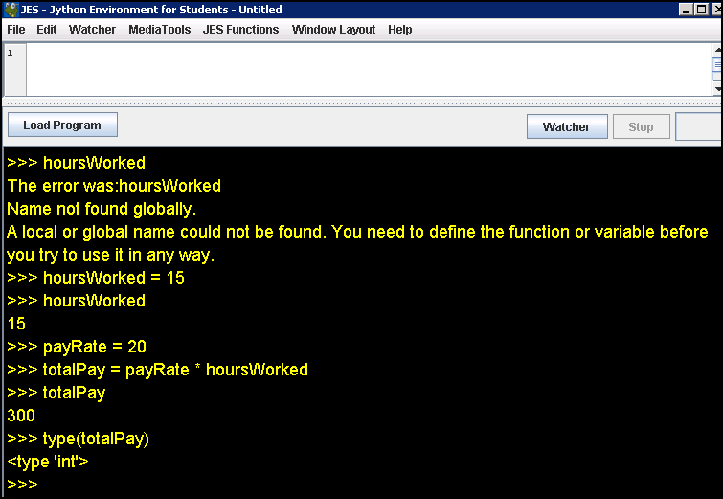
Python Session

Slide 31
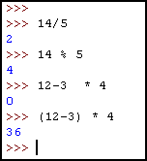
Python Session

Slide 32
What about floats?
When computing with floats, / will indicate regular division with fractional results.
Constants will have a decimal point.
14.0/5.0 will give 2.8 while 14/5 gives 2.

Slide 33
Comments
Often we want to put some documentation in our program. These are comments for explanation, but not executed by the computer.
If we have # anywhere on a line, everything following this on the line is a comment – ignored

Slide 34
Numerical Input
To get numerical input from the user, we use an assignment statement of the form <variable> = input(<prompt>)
Here
<prompt> would be replaced by a prompt for the user inside quotation marks
If there is no prompt, the parentheses are still needed
Semantics
The prompt will be displayed
User enters number
Value entered is stored as the value of the variable

Slide 35
Print Statement
For output we use statements of the form print <expression>
Semantics
Value of expression is computed
This value is displayed
Several expressions can be printed – separate them by commas

Slide 36
Example - Fahrenheit to Centigrade
We want to convert a Fahrenheit temperature to Centigrade.
The formula is C = (F -32) x 5/9
We use type float for the temperatures.

Slide 37
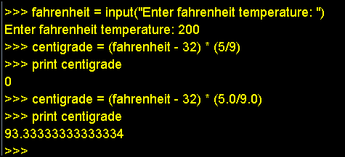
Python Session

Slide 38
If we figure this out once,
let’s remember what we did!

